Slide 1

ASSIGNMENT GUIDELINES
Make the changes in the PPT as you solve the parts
This file contains the template for all the parts of the project.
Check the instructions added in the note section of every slide for clarity.
Don’t move around any image or text box
If you require more/lesser elements, be careful when you copy/delete the existing ones.

Slide 2
ASSIGNMENT
Name: Ridhima Atrey
Problem Statement
The sales pipeline conversion percentage at TechnoServe (a tech SaaS startup) has dropped from 35% at the end of last fiscal (FY 2017-18) to 25% at present.
Assignment Objective
Understand the problem, come up with a hypothesis for low conversions faced by TechnoServe, and analyse the dataset provided to arrive at possible solutions to increase it.
Notes:
Problem Statement

Slide 3
PART I : 1. Understanding the Problem
Sales Pipeline Conversion at a SaaS Startup
Who?
TechnoServe, a tech SaaS company founded in yr 2010.
Located in Pune with over 600 employees.
What?
There is a drop in sales pipeline conversion percentage by 10%.
(It has dropped from 35% to 25%.)
When?
Occurring over the last 3 quarters.
Around the end of the last fiscal (fy 2017-2018).
Where?
Among the clients across different cities.
How?
Sales and customer related issue.
Marketing on the wrong channels.

Slide 4
PART I : 2. Understanding the Problem
Sales Pipeline Conversion at a SaaS Startup
Situation
What is the current sales conversion rate and how it has changed in the last 3 quarters?
Is there any thing that has changed recently in the last 3 quarters?
What Channels are being used currently for marketing?
What processes the sales team follow while converting the leads?
Problem
Is there any specific level where the drop is happening?
Is there any difference in conversion rate across the cities?
Is there any customer feedback about the services?
Is there any new competition entered in the market?
Implication
What is the impact of this drop in conversion on the revenue?
How is this affecting the investors to invest in future?
If it continues, what effect can be seen in the long term on business growth?
Need-Payoff
I team focus on better communication with clients will that help in conversion?
If sales team trained well or avoided over promising, how would it affect sales conversion?
Would shifting the marketing to the right channels with the target customers improve the sales conversion?
Notes:
Provide at least three questions under each branch.

Slide 5
PART II : Formulating Hypotheses
Sales Pipeline Conversion at a SaaS Startup
Framework Used
Issue Tree Framework
Reason for using the selected framework
I used this to break down the problem into smaller parts to identify all the possible causes of low conversion rates.
How you have used the framework here
To apply this framework, I took both the business owner and customer perspective and asked what problems I can face by the customer and for what reasons they can arise. I thought about the different reasons keeping MECE in mind and categorized into sales process, marketing, customer satisfaction and behavior. I also referred 5W framework and 5WHYs explained in the video.
Notes:
All the frameworks that are used should be mentioned.
A suitable reason is a must to provide here

Slide 6
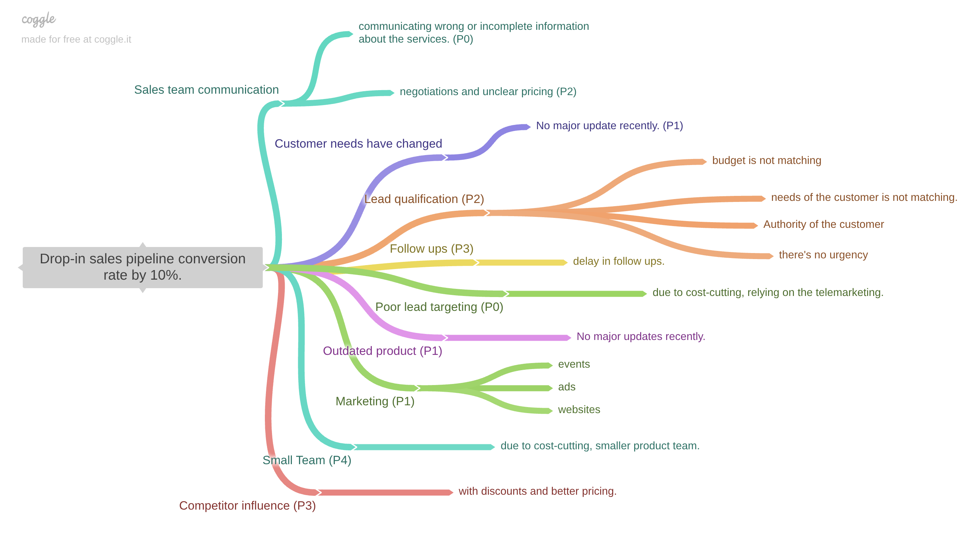
PART II : Formulating Hypotheses
Sales Pipeline Conversion at a SaaS Startup
Issue Tree Framework
Provide the structure of the framework here
(You can attach the screenshot or multiple screenshots depending on the clarity of the image)
Notes:
Use the “download as” feature of Coggle if you are using the tool.
Provide one image with complete tree along with separate elements where the text is readable.
Copy the slide if you require more space

Slide 7
PART II : Formulating Hypotheses
Sales Pipeline Conversion at a SaaS Startup
Marketing Issue
The marketing channels are not reaching the right audience, which could be why the conversion rate is low.
Outdated Product
The product features might not be updated to match the market needs, leading to lost opportunities.
Notes:
Each branch must follow this naming pattern:
Problem – Branch 1 – Sub-branch 1 – Sub-branch 2 – …… – Hypotheses
There must be minimum 10 hypotheses in total and at least 1 in each branch.

Slide 8
PART II : Formulating Hypotheses
Sales Pipeline Conversion at a SaaS Startup
Sales team communication
The sales team might not be explaining the product benefits clearly in the demo or gaining incomplete information about the services, leading to the lack of trust among clients and confuses them.
Competitor Influence
Competitors might be providing discounts and better pricing and making it more difficult for the team to convert clients.
Notes:
Each branch must follow this naming pattern:
Problem – Branch 1 – Sub-branch 1 – Sub-branch 2 – …… – Hypotheses
There must be minimum 10 hypotheses in total and at least 1 in each branch.

Slide 9
PART II : Formulating Hypotheses
Sales Pipeline Conversion at a SaaS Startup
Lead Qualification
We may be talking to leads who are not the right fit for purchase. The lead budget might be too small or not have the authority to decide leading to fail in conversion.
Follow-ups
Due to the delays in follow-up may cause potential clients to lose interest or some leads might not even getting any follow ups for many days after a demo.
Notes:
Each branch must follow this naming pattern:
Problem – Branch 1 – Sub-branch 1 – Sub-branch 2 – …… – Hypotheses
There must be minimum 10 hypotheses in total and at least 1 in each branch.

Slide 10
PART II : Formulating Hypotheses
Sales Pipeline Conversion at a SaaS Startup
Poor Lead Targeting
The marketing is not reaching the right audience due to using the wrong marketing channels. Due to cost cutting the company mostly relying on telemarketing intsead of targeting high potential clients.
Small Team
Due to cost cutting , company keeping a small team which may be slowing down the process and the team is not able to handle the high load of work leading to the low conversion.
Notes:
Each branch must follow this naming pattern:
Problem – Branch 1 – Sub-branch 1 – Sub-branch 2 – …… – Hypotheses
There must be minimum 10 hypotheses in total and at least 1 in each branch.

Slide 11
PART II : Formulating Hypotheses
Sales Pipeline Conversion at a SaaS Startup
Pricing & Negotiation Issues
Our pricing or negotiation approach may be unclear to clients.
Customer Needs Have Changed
Clients’ needs have changed now as there are no major updates happened recently from past 3 quarters.
Notes:
Each branch must follow this naming pattern:
Problem – Branch 1 – Sub-branch 1 – Sub-branch 2 – …… – Hypotheses
There must be minimum 10 hypotheses in total and at least 1 in each branch.

Slide 12
PART III A : Generating Insights
Sales Pipeline Conversion at a SaaS Startup
Variable
Technology Primary
Insights if any
ERP Implementation has the highest total number of Won opportunities (11,629).
Analytics has the highest conversion rate (26%) but the total number of opportunities are low.
Pattern of Insight
ERP Implementation is performing better in sales conversion.
Legacy Modernization has lowest conversion rate with just 12%.
Notes:
Analyse the variables in the dataset, find the insights and mention the pattern of insights in the data. Make more copies of this slide if needed.

Slide 13
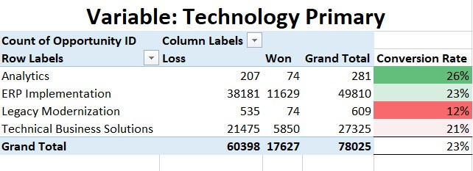
PART III A : Generating Insights
Sales Pipeline Conversion at a SaaS Startup
Variable under consideration: Technology Primary
In a pivot table where Technology Primary was in rows and Opportunity status was in columns. Then conversion rate of Won was calculated based on the total leads generated.
That was calculated as = count of won’s / Grand total.
Which shows Analytics has the highest conversion rate with 26% and Legacy Modernization has the lowest with just 12%.
ERP Implementation has the highest total count of won (11,629) which means that ERP is converting more no. of leads than any other category even though Analytics has the highest conversion rate ERP Implementation seems more profitable. The lowest conversion rate is in Legacy Modernization as others are just fine. The category showing more wins is not the one with the highest conversion rate.
Pattern of insight: Surprising Comparison.
Notes:
For each variable that produced an interesting insight, explain you analysis bit here – the results you got from excel and the necessary visualisations. Note: it is compulsory for you to mention the results of the analysis on these variables - 'Technology Primary', 'B2B Sales Medium', 'Client Revenue Sizing', 'Opportunity Sizing' and 'Business from Client last year’.

Slide 14
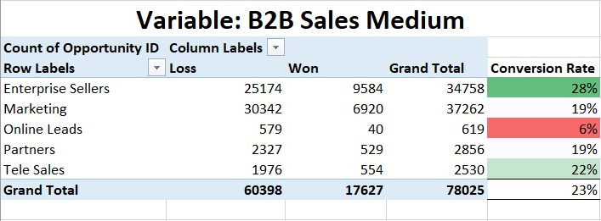
PART III A : Generating Insights
Sales Pipeline Conversion at a SaaS Startup
Variable under consideration: B2B Sales Medium
Here with the help of Pivot table best and worst conversion rate is calculated of all the market channels. Where Enterprise Sellers has the conversion rate with 28% and Online leads has the lowest conversion rate with 6%.
Which shows that the online leads channel is not performing well. Enterprise sellers is the highest performing channel and working best for the company. There’s a huge gap between the top performing and the worst performing channels.
Pattern of insight- Surprising extreme.
Notes:
For each variable that produced an interesting insight, explain you analysis bit here – the results you got from excel and the necessary visualisations. Note: it is compulsory for you to mention the results of the analysis on these variables - 'Technology Primary', 'B2B Sales Medium', 'Client Revenue Sizing', 'Opportunity Sizing' and 'Business from Client last year’.

Slide 15
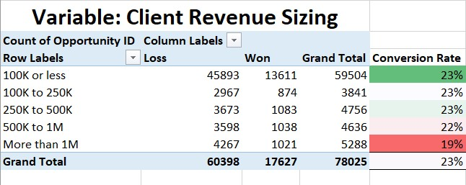
PART III A : Generating Insights
Sales Pipeline Conversion at a SaaS Startup
Variable under consideration: Client Revenue Sizing
Clients having revenue less than or equal to 100K and 100K-250K have similar conversion rate (23%).
The clients whose revenue size is greater than 1 million has the lowest conversion rate of 19%.
Which shows the company sells more successfully to small and mid sized clients. The conversion rate decreases as revenue size increases.
Pattern of insight: Abnormal distribution.
Notes:
For each variable that produced an interesting insight, explain you analysis bit here – the results you got from excel and the necessary visualisations. Note: it is compulsory for you to mention the results of the analysis on these variables - 'Technology Primary', 'B2B Sales Medium', 'Client Revenue Sizing', 'Opportunity Sizing' and 'Business from Client last year’.

Slide 16
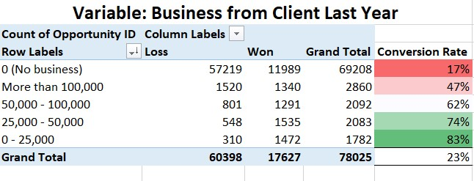
PART III A : Generating Insights
Sales Pipeline Conversion at a SaaS Startup
Variable under consideration: Business from Last year.
In this Clients with no 0 past business converted poorly with just 17% and Clients with 0-25K business converting extremely well with 83%.
Which shows that the clients with no past business (new customers) converting poorly can be due to lack of trust and harder to gain new clients in comparison to the older ones. The existing customers but with small purchases 0-25K are converting extremely well.
Notes:
For each variable that produced an interesting insight, explain you analysis bit here – the results you got from excel and the necessary visualisations. Note: it is compulsory for you to mention the results of the analysis on these variables - 'Technology Primary', 'B2B Sales Medium', 'Client Revenue Sizing', 'Opportunity Sizing' and 'Business from Client last year’.

Slide 17
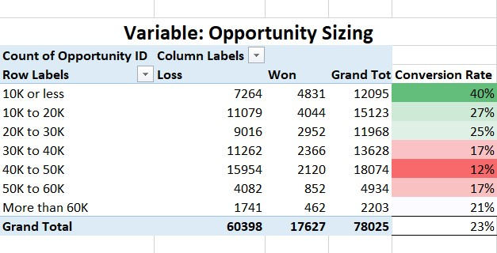
PART III A : Generating Insights
Sales Pipeline Conversion at a SaaS Startup
Variable under consideration: Opportunity Sizing
Small opportunities (10K or less) have the highest conversion rate (40%) which suggests they are easier to convert. The mid sized opportunities (30K-50K) have the lowest conversion rate (12%-17%), whereas the very large opportunities (greater than 60K) are much better than mis sized with 21%.
Notes:
For each variable that produced an interesting insight, explain you analysis bit here – the results you got from excel and the necessary visualisations. Note: it is compulsory for you to mention the results of the analysis on these variables - 'Technology Primary', 'B2B Sales Medium', 'Client Revenue Sizing', 'Opportunity Sizing' and 'Business from Client last year’. Make more copies of this slide if needed.

Slide 18
PART III A : Generating Insights
Sales Pipeline Conversion at a SaaS Startup
Recommendations
Even though Analytics has the highest conversion rate ERP Implementation might be more profitable. So, improving the ERP sales approach could give a big boost to total conversions.
For low conversion sales medium such as online, needs to be improved or changed as it might be targeting the wrong audience.
Large clients (high revenue size) and mid sized have low conversion rates. They may require better features or pricing.
The more focus should be on the small amount of deals as these show highest conversion rate and easier to close.
Corresponding Insights
Technology Primary
ERP Implementation has highest number of wins but lower conversion rate than Analytics.
B2B Sales Medium
Online leads have lowest conversion compared to other mediums.
Client Revenue Sizing
Conversion rate decreases sharply for large revenue clients.
Opportunity Sizing
10K or less opportunities have highest conversion (40%) while 30K–50K are lowest (12%–17%).
Notes:
For each recommendation explain the insights that form the reasoning for giving that recommendation. Make more copies of this slide if necessary.

Slide 19
PART III B : Presenting Findings
Sales Pipeline Conversion at a SaaS Startup
Improving Conversion Rate at Technoserve
Focus on high conversion segments and fix low performing categories to improve overall conversion from 23%-30% .
Prioritise: Small past business clients (0–25K), small opportunity size deals (≤10K), and Analytics technology segment for short-term wins.
Fix: Mid sized opportunities (30K–50K), large revenue size clients (>100,000), and low performing cities like Pune.
Improve: Online sales targeting to better reach high potential customers.
Reduce unnecessary sales iterations to close deals faster.
Notes:
You are free to use the elements and boxes mentioned previously. Make sure you’re using the pyramid principle, data visualization, visual design principle and storyboarding concepts to design these slides.

Slide 20
PART III B : Presenting Findings
Sales Pipeline Conversion at a SaaS Startup
Segment Performances:
Best – Analytics (26%), Mumbai (25%), ≤10K opportunities (40%), past business 0–25K (83%).
Worst – Legacy Modernization (12%), Pune (19%), 30K–50K opportunities (12%–17%), no past business (17%).
Sales Process:
0–1 sales iteration = higher conversion (64%); high iterations = 0% conversion
Competition Impact:
No known competitor = 32% conversion, known competitors = 19%
Notes:
You are free to use the elements and boxes mentioned previously. Make sure you’re using the pyramid principle, data visualization, visual design principle and storyboarding concepts to design these slides.

Slide 21
PART III B : Presenting Findings
Sales Pipeline Conversion at a SaaS Startup
Short Term Actions (Quick Wins)
Target small past-business clients and small deal sizes actively.
Push ERP Implementation category while keeping Analytics in focus.
Long-Term Actions
Train sales team to reduce unnecessary iterations.
Develop competitive positioning strategy for markets with strong rivals by updating the features or providing better pricing.
Expected Impact
Rise in conversion rate from 23% → 30%+ within next cycle.
Notes:
You are free to use the elements and boxes mentioned previously. Make sure you’re using the pyramid principle, data visualization, visual design principle and storyboarding concepts to design these slides.

